Slide 1
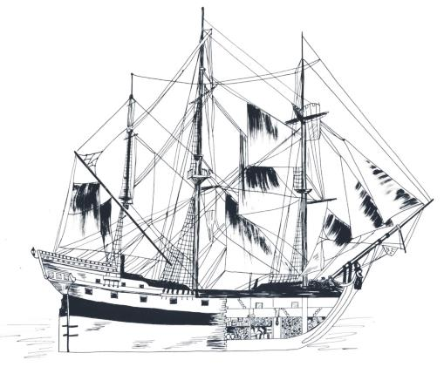
El Nuevo Constante 1766
Learn about Louisiana’s Past through Archaeology
Notes:
Title: El Nuevo Constante –1766
Image credit: Louisiana Division of Archaeology

Slide 2
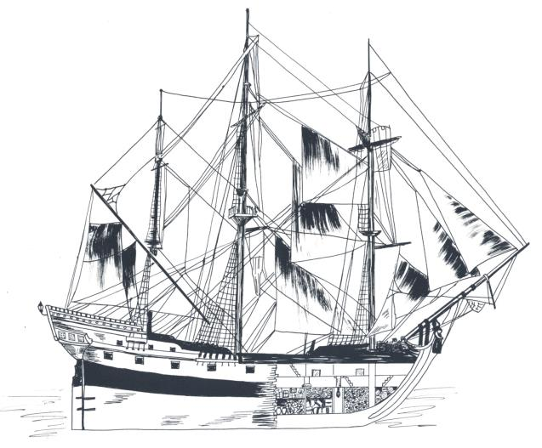
El Nuevo Constante
Drawing of El Nuevo Constante
Notes:
El Nuevo Constante – A.D. 1766
This module introduces the colonial shipwreck of El Nuevo Constante (pronounced El Noo-ay’ voh Con-stahn’ tay). That is the name its Spanish owners gave the ship. In this presentation, it is also called the Constante. The discovery of this site offered a rare look into the business of trade during the colonial period. This is a drawing of what the ship looked like in 1766.
Image credit: Louisiana Division of Archaeology

Slide 3
El Nuevo Constante
El Nuevo Constante 1766
Spanish trading ship
Wrecked near Louisiana coast
Goods from Mexico on board
First colonial shipwreck discovered in Louisiana
Notes:
El Nuevo Constante – A.D. 1766
The Constante was an eighteenth-century Spanish trading ship. It wrecked near the coast of Louisiana in 1766. The Constante had goods from Mexico on board at the time of the wreck. A fisherman discovered the wreck in the Gulf of Mexico in 1979. This was the first colonial shipwreck discovered in Louisiana, and it offered a chance to learn more about trade in the colonial period.

Slide 4
El Nuevo Constante
France transfers Louisiana to Spain
Treaty of Fountainebleu
A.D. 1762
LaSalle claims
Louisiana for France
A.D. 1682
Louisiana Purchase
A.D. 1803
de Soto expedition
in Louisiana
A.D. 1542
El Nuevo Constante
wrecks A.D. 1766
Pre-European Contact Period
A.D. 1400-1500
Colonial Period
A.D. 1500 -1803
A.D. 1400 | A.D. 1500 | A.D. 1600 | A.D. 1700 | A.D. 1800
Renaissance Period
begins in Italy
A.D. 1400
Scientific Revolution
begins in Europe
A.D. 1600
American Revolution
begins A.D. 1775
Ponce de Leon
discovers Florida
A.D. 1513
Columbus in the
New World
A.D. 1492
Age of Enlightenment
begins in Europe
A.D. 1700
Treaty of Paris
Revolutionary War
ends A.D. 1784
Timeline of events in Louisiana and the world from A.D. 1400 to A.D. 1803
Notes:
El Nuevo Constante – A.D. 1766
Let’s put the Constante in the context of early colonial activity in Louisiana, and what was going on in the rest of the U.S. and the world. Here is a timeline of events from A.D. 1400 to 1803.
Image credit: Louisiana Division of Archaeology

Slide 5
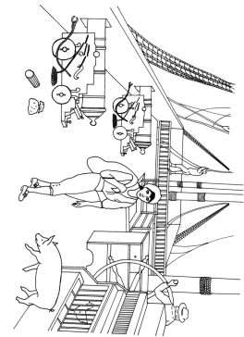
El Nuevo Constante
Views of El Nuevo Constante
Notes:
El Nuevo Constante – A.D. 1766
The Constante transported cargo to and from Mexico and Spain. The drawing on the left shows where the cargo was stored. The ship carried cannons and other arms for protection. It was not uncommon for livestock to roam the deck of the ship in these days. They provided fresh meat during the long journey across the ocean. There is no historical picture of the ship. An artist used information from archaeology and historical research to make these drawings.
Image credit: Louisiana Division of Archaeology

Slide 6
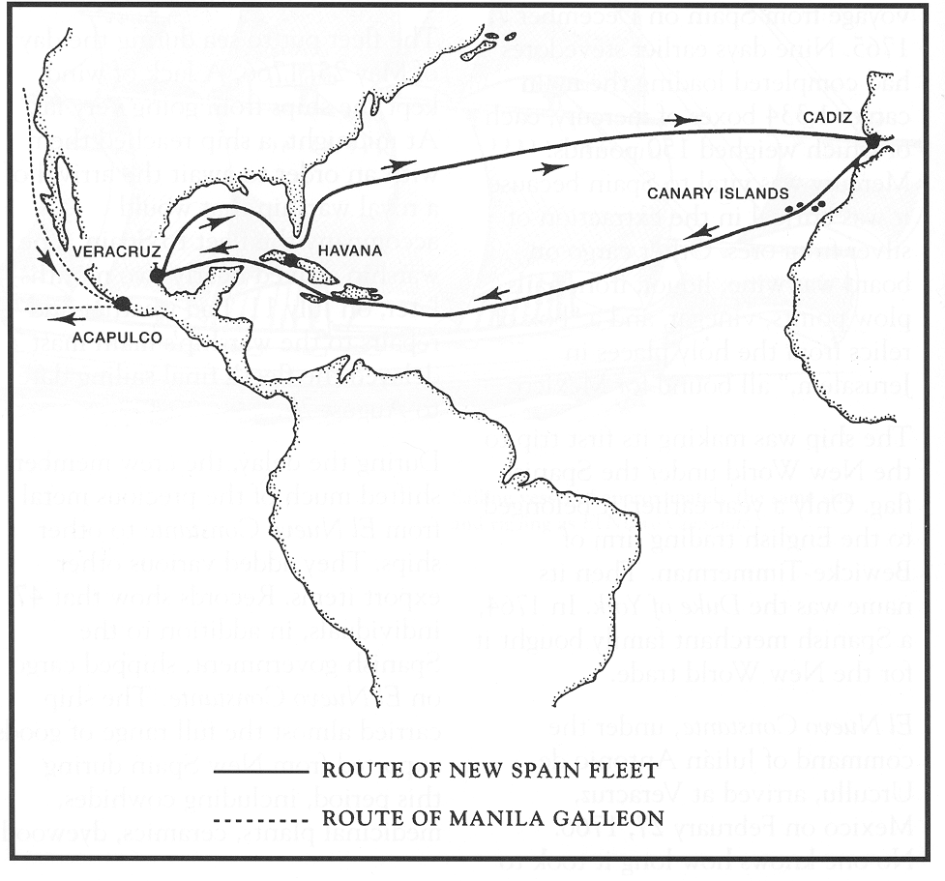
El Nuevo Constante
Spain
North America
Louisiana
Mexico
Africa
Caribbean Ocean
Pacific Ocean
Atlantic Ocean
South America
Route of El Nuevo Constante
Notes:
El Nuevo Constante – A.D. 1766
Here is a map of the route of the Constante. In September 1766, the ship left Mexico to return to Spain. It sailed as part of a fleet, or a group of ships, carrying cargo and passengers. At this time, Mexico was a Spanish colony. These ships carried Mexican goods back to Spain for Spanish merchants. Examples of these products were tanned hides, raw material to make dyes, medicine products, vanilla pods and chocolate, ceramics, and tortoise shell. The Constante also carried copper, silver, and gold.
September was during hurricane season. When the fleet sailed, there was a severe storm in the Gulf of Mexico. Soon, the ships were scattered, and the Constante was alone. The storm was so rough the ship began to leak and take on water. The captain turned toward shore, hoping to get the Constante and all aboard to safety before the ship sank. The ship ran aground before reaching shore and was stuck in 10 feet of water, just off the Louisiana coast near Cameron Parish. The people on the Constante remained on board for two more days while the storm continued. Finally, the storm cleared enough for the crew and passengers to take shelter on the Louisiana coast.
Image credit: Louisiana Division of Archaeology

Slide 7
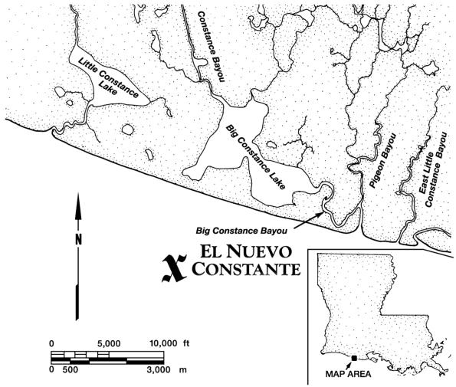
El Nuevo Constante
Drawing from Coastal Environments, Inc.
Balize
General area of the shipwreck of El Nuevo Constante
Notes:
El Nuevo Constante – A.D. 1766
This map shows the general location of the Constante shipwreck. “X” marks the spot! For several days after the storm, the captain and crew of the Constante salvaged what they could of their cargo. The captain then sent several crew members in one of the ship’s smaller boats to the Spanish fort at Balize with word of the disaster, and to ask for help.
At this time Spain controlled much of Louisiana. France gave Louisiana west of the Mississippi River to Spain in 1762 with the Treaty of Fountainebleu. The Spanish governor of Louisiana was Don Antonio de Ulloa. When Ulloa heard what happened to the Constante, he immediately sent help. Many people and several ships worked through October 1766 to save what they could of the Constante’s cargo. They abandoned the ship, and the sea soon claimed the Constante. But, that wasn’t the end of the story . . .
Image credit: Coastal Environments, Inc.

Slide 8
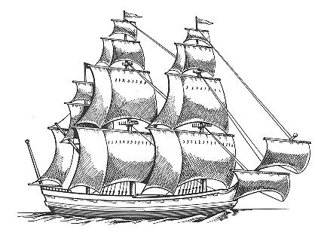
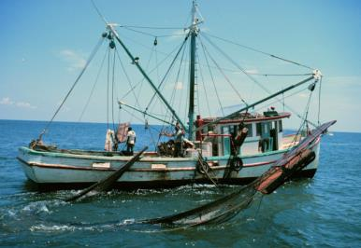
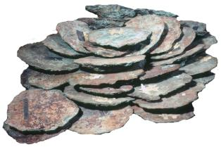
El Nuevo Constante
NOAA; Robert K. Brigham
Drawing of El Nuevo Constante-style ship, 1766
(Stan Dark © 1997)
Photograph of Texas shrimp trawler
Copper ingots from El Nuevo Constante
Photograph by Coastal Environments, Inc.
Notes:
El Nuevo Constante – A.D. 1766
Now, let’s fast forward 213 years to 1979 when a Texas shrimper discovered the wreck site of the Constante. The trawler, which is a boat used to catch shrimp, snagged part of the shipwreck with its net. In the shrimp net were three large copper ingots, or disks. The captain wasn’t sure what to make of his catch. He thought it was metal debris left behind by a drilling operation. However, he noted the position of the snag on his map for future reference, and put the disks in the bed of his truck. A friend who had some experience with shipwrecks noticed the items in his truck, and suggested that they might be from a shipwreck.
Image credits:
El Nuevo Constante-style ship – Stan Dark © 1997
Shrimp trawler – National Oceanic and Atmospheric Administration/Department of Commerce; http://www.fishwatch.gov/profiles/brown-shrimp; Image ID: fish0809; Photograph by Robert K. Brigham
Ingots – Coastal Environments, Inc.

Slide 9
El Nuevo Constante
Louisiana’s
Territorial
Sea
Louisiana’s Exclusive Economic Zone
12 nm
24 nm
200 nm
Territorial
Waters
Continental Shelf
Shoreline
Territorial sea and ownership (nm = nautical miles)
Notes:
El Nuevo Constante – A.D. 1766
There was a question of who owned the shipwreck. It was important to find out whether the wreck was located within Louisiana’s territorial sea. A territorial sea is the area 12 nautical miles from the coast. A nautical mile is not the same distance as a regular mile. It measures distance on water, and is equal to 1.15 miles on land. This area belongs to the coastal state. There are laws that determine what can take place within this state-controlled area, and who owns objects found in this area. It turned out that the wreck belonged to the state of Louisiana. The Louisiana Department of Culture, Recreation, and Tourism became involved with the discovery. This office is responsible for managing cultural resources on state property.
The state wanted to study the site. The fishermen who found the wreck, a local archaeology company, and the state agreed on a plan. They worked together to research, recover, analyze, and store artifacts from the Constante.
Image credit:
Territorial sea diagram - Louisiana Division of Archaeology

Slide 10
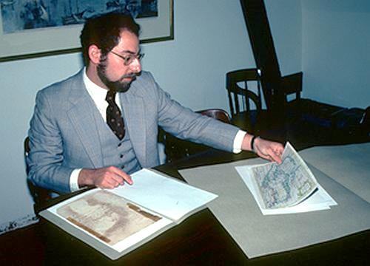
El Nuevo Constante
Primary Sources for this Project
1785 journal entry about Bayou del Constance
Historical archives in Mexico and Spain
Ship’s manifest (list of cargo, crew and passengers)
Historical maps
Artifacts from the shipwreck
Notes:
El Nuevo Constante – A.D. 1766
Historical Research
Researchers were not sure of the name of the ship at first. Historical research and analysis of the items recovered from the shipwreck gave them many clues that this was the Constante. Examples of the primary sources that researchers examined for this project are:
1785 journal entry about Bayou del Constance
Historical archives in Mexico and Spain
Ship’s manifest, which is a list of cargo, crew and passengers
Historical maps
Artifacts from the shipwreck
These documents and objects confirmed the identity of the ship.
Image credit: Louisiana Office of Tourism

Slide 11
El Nuevo Constante
Archaeological Investigations
Remote sensing survey
Cores to study sediment layers of seafloor
Underwater measurements of ship
Artifact recovery, analysis, and conservation
Reporting
Notes:
El Nuevo Constante – A.D. 1766
Archaeological Investigations
Here is an outline of the overall plan for the archaeology. The work began with a remote sensing survey. “Remote sensing” is a way to collect data without touching the area or objects. The most useful technique for this project was the side scan sonar. It mapped the seafloor using sound waves to record contours and objects. This information gave archaeologists the exact location of the wreck and how it lay on the sea floor.
Soil cores provided information on the sediment layers of the seafloor above and below the wreck site. This information told archaeologists that preservation of some of the artifacts was good. Clay soil preserves organic material, such as wood, fabric, and leather, because it provides a low-oxygen atmosphere, which prevents decay.
Divers took measurements of the ship underwater. The measurements, along with analysis of the artifacts, further confirmed this was the Constante. Finally, the artifacts from the site were carefully cleaned, analyzed, conserved, and stored. A book and brochure reported the work.

Slide 12
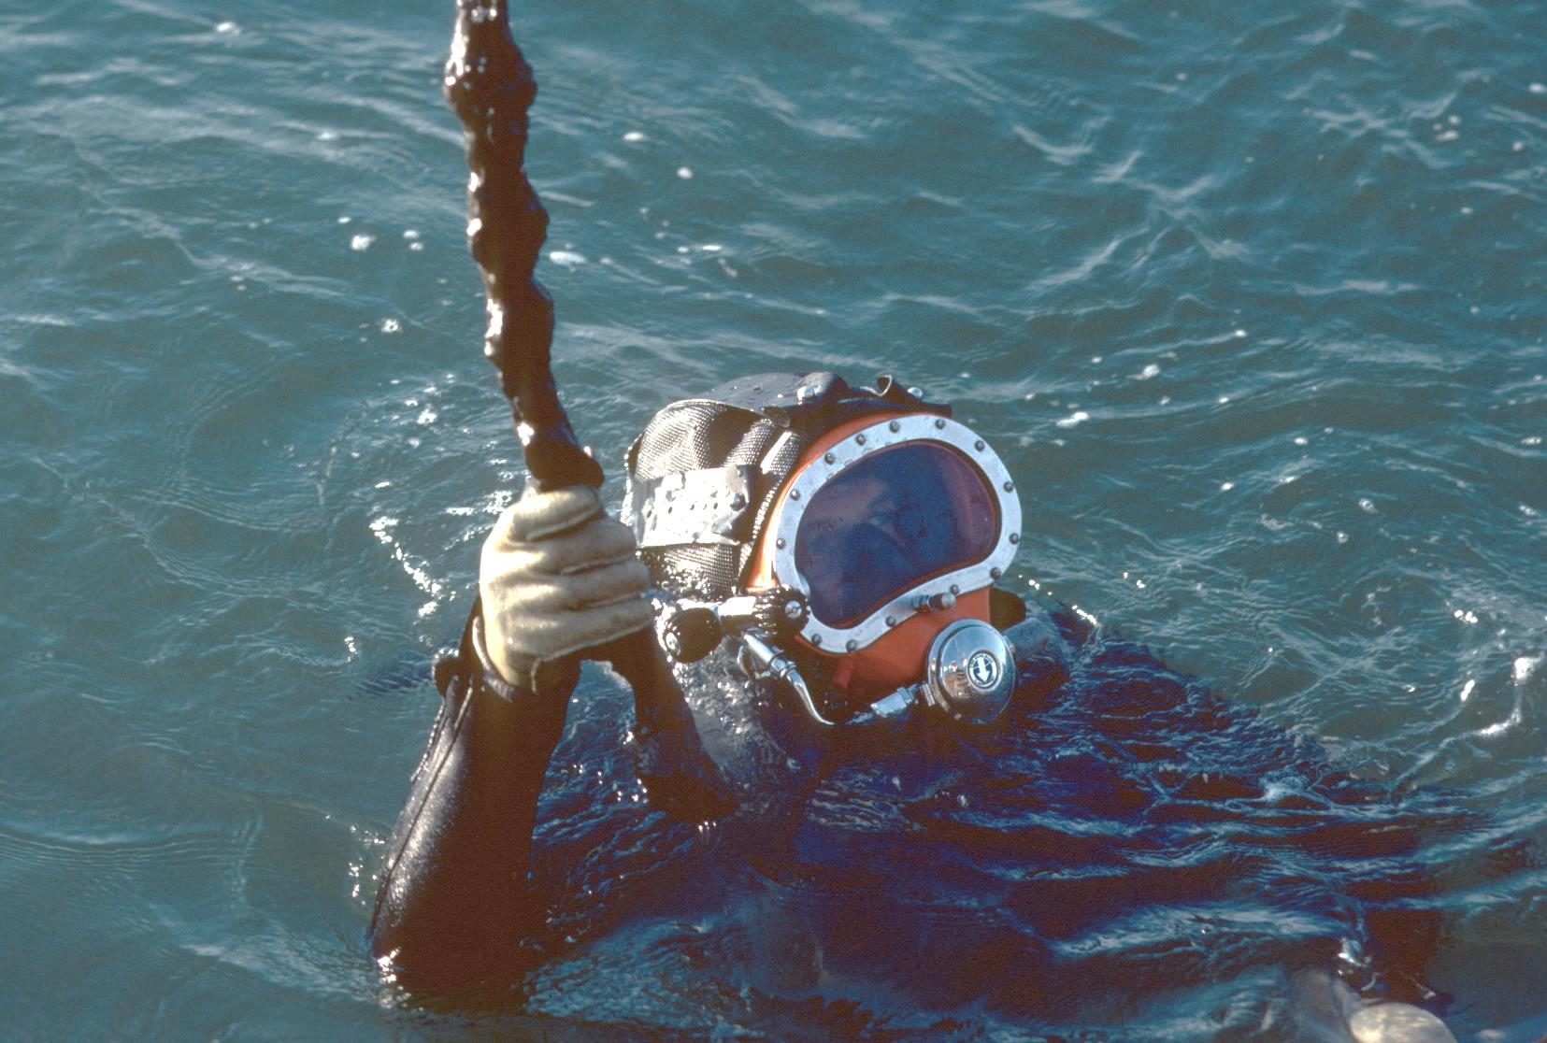
El Nuevo Constante
Challenging diving conditions for El Nuevo Constante
Notes:
El Nuevo Constante – A.D. 1766
Diving on the Constante was challenging. The water was so murky the divers couldn’t see their hands in front of their faces, and strong water currents crossed the wreck. But, this was the first colonial shipwreck discovered in Louisiana, and it had the potential to be of great historical importance. The team decided to move forward with the investigation.
Image credit: Louisiana Office of Tourism

Slide 13
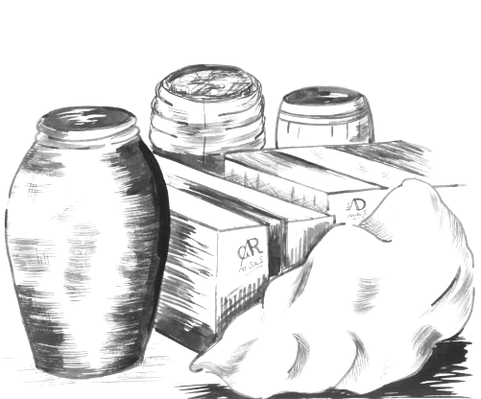
El Nuevo Constante
Artifacts Recovered, 1979 to 1980
Cannon, cannon balls and shot
Glass
Pottery, olive jars
Silver, gold and copper ingots
Raw material to make dyes
Ceramic cargo
Hides
Turtle shells
Notes:
El Nuevo Constante – A.D. 1766
Here is a list of some artifacts recovered from the Constante from 1979 to 1980. The following slides feature these artifacts.
Image credit: Louisiana Division of Archaeology

Slide 14
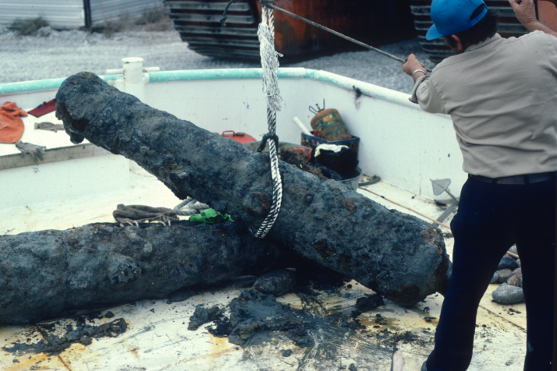
El Nuevo Constante
Photograph by Coastal Environments, Inc.
Cannons from El Nuevo Constante
Notes:
El Nuevo Constante – A.D. 1766
Two cannons were recovered from the Constante. There were 22 cannons on board when the ship sailed from Spain in 1765: eighteen 8-pounder cannons, and four 4-pounder cannons. “Pounder” refers to the weight of the cannon ball used in the cannon. These cannons were made of iron, and did not preserve well in salt water.
The cannons in this photograph are 8-pounders. Archaeologists did not find any of the 4-pounder cannons from the wreck.
Image credit: Coastal Environments, Inc.

Slide 15
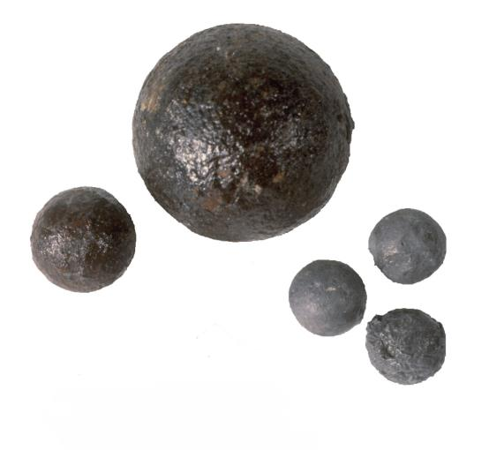
El Nuevo Constante
8-pounder
cannon ball
canister
shot
wood base
lead shot
4-pounder
cannon ball
Cannon balls and shot from El Nuevo Constante
Notes:
El Nuevo Constante – A.D. 1766
Here is a photograph of cannon balls and shot from the Constante. Canister shot was small, and many were stacked in a wooden or metal container, as shown in the diagram on the right. Sailors used these canisters only when the enemy got close. The shot scattered once fired from the cannon, to do the most damage to ship and crew.
Image credits:
Photograph of cannon ball and shot – Louisiana Division of Archaeology
Canister diagram – Louisiana Division of Archaeology

Slide 16
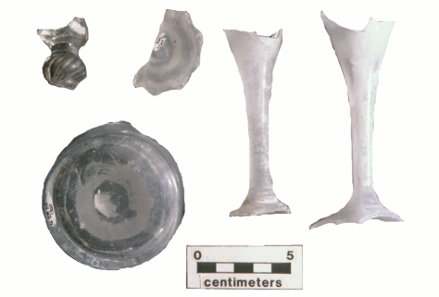
El Nuevo Constante
Louisiana Office of Tourism.
Wine Bottle Base
Coastal Environments, Inc.
Glass fragments
Glass artifacts from El Nuevo Constante
Notes:
El Nuevo Constante – A.D. 1766
Here are glass artifacts recovered from the Constante. There were glass fragments from various containers used on board, such as wine bottles, and pieces of wine glasses.
Image credits:
Louisiana Office of Tourism (left)
Coastal Environments, Inc. (right)

Slide 17
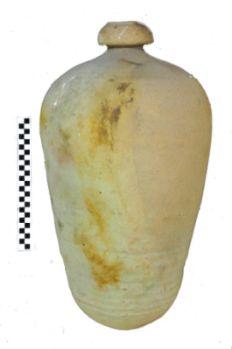
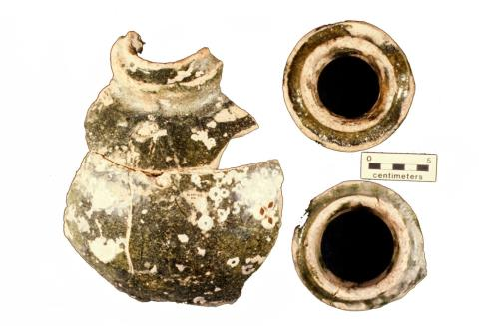
El Nuevo Constante
Photograph by Coastal Environments, Inc.
Photograph by Odyssey Marine Exploration
Spanish olive jar fragments
from El Nuevo Constante
Example of complete
Spanish olive jar
Spanish Olive Jar
Notes:
El Nuevo Constante – A.D. 1766
Archaeologists found pieces of big pottery containers, called olive jars, on the Constante. The photograph on the left is from the Constante. The photograph on the right is an example of a complete jar of similar style. Sometimes olive jars stored olives, sometimes they stored other things.
Image credits:
Fragments from El Nuevo Constante – Coastal Environments, Inc.
Complete olive jar – Odyssey Marine Exploration www.odysseymarine.com; Odyssey’s Virtual Museum www.odysseysvirtualmuseum.com

Slide 18
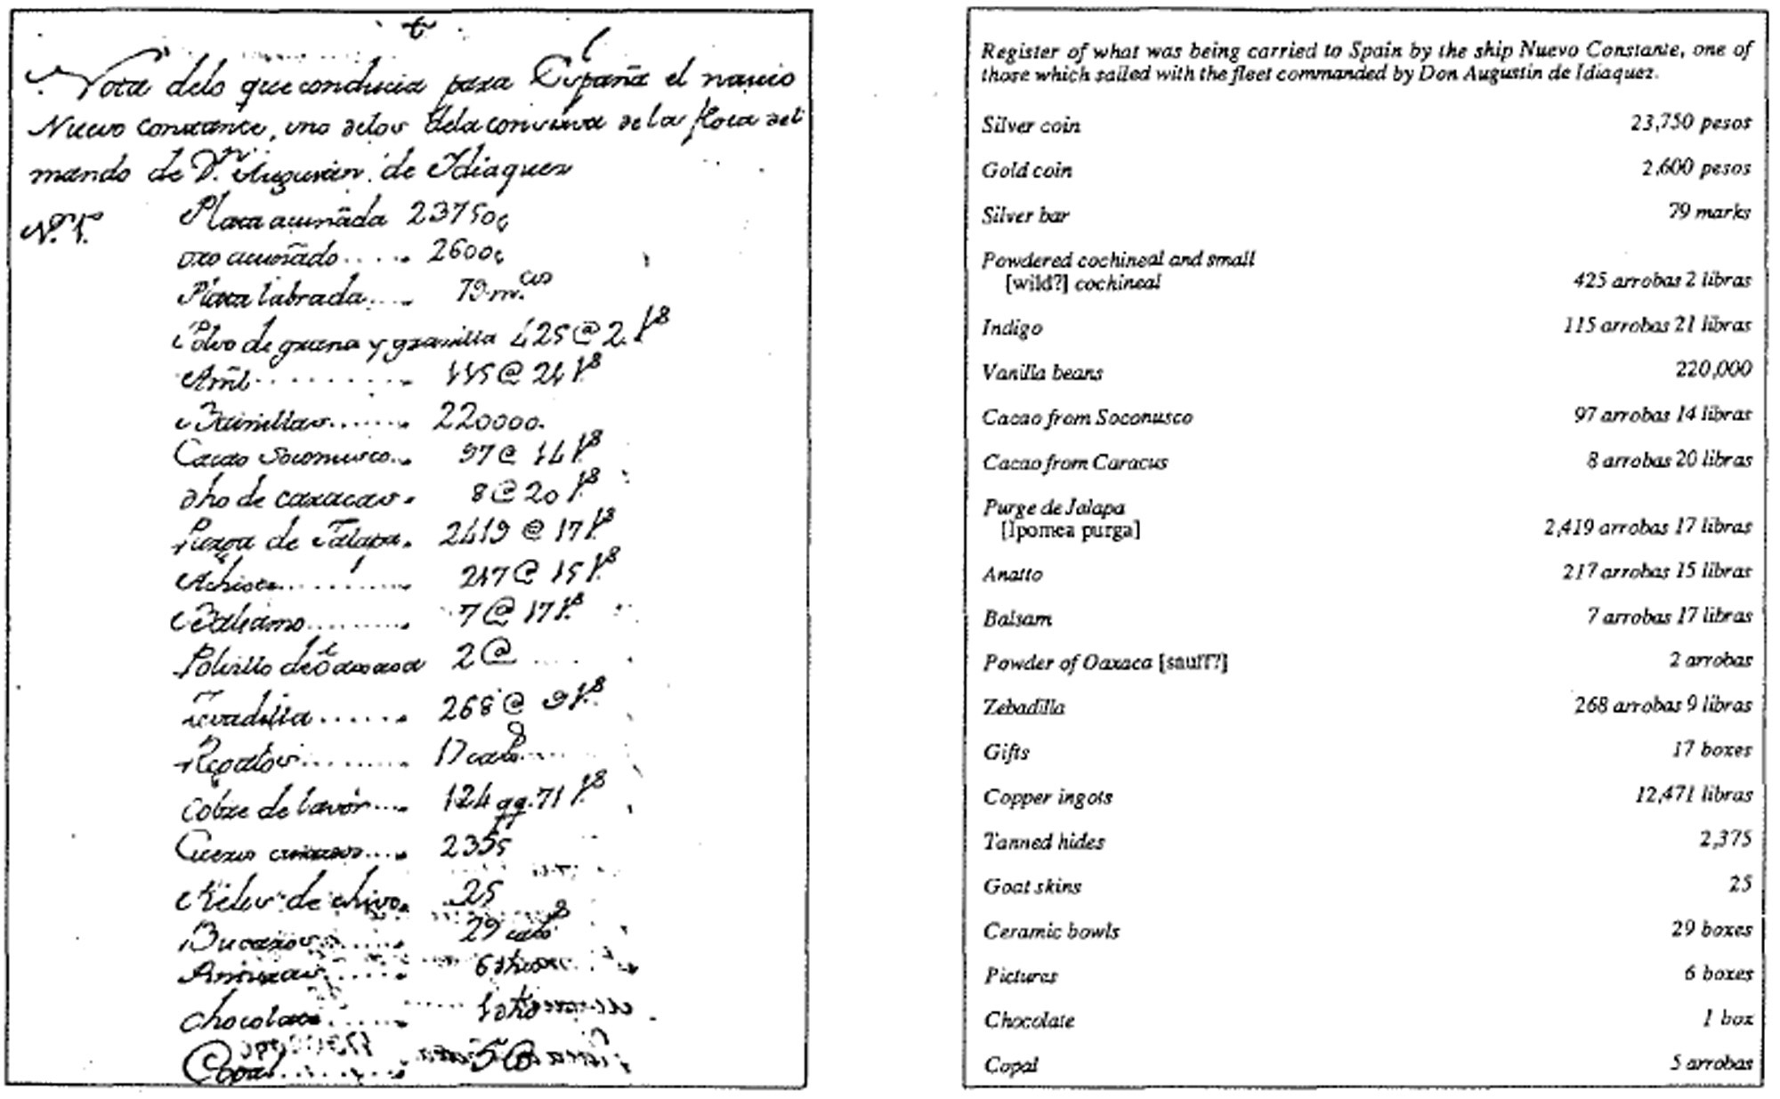
El Nuevo Constante
Cargo list of El Nuevo Constante, 1766
Notes:
El Nuevo Constante – A.D. 1766
This list shows some of the cargo aboard the Constante when it sailed for Spain in 1766. The original language is in Spanish on the left, with an English translation on the right. Archaeologists did not find all of these items. The salvage effort right after the wreck removed most of the valuable merchandise, such as the coins.
Image credits: Original document in Spanish courtesy Archivo General de Indias, Contratación, 2071. In: Pearson and Hoffman (1998), El Nuevo Constante: Investigation of an Eighteenth-Century Spanish Shipwreck off the Louisiana Coast, 2nd ed., Louisiana Department of Culture, Recreation and Tourism.

Slide 19
El Nuevo Constante
Gold ingots
Silver ingots and artifacts
Photographs by Coastal Environments, Inc.
Precious metals from El Nuevo Constante
Notes:
El Nuevo Constante – A.D. 1766
Silver was the most valuable export item from Mexico in colonial times. Historical accounts of the salvage in 1766 recorded more gold and silver from the Constante than was on the cargo list when the ship left Mexico. Spanish authorities suggested that the pieces were smuggled, which was common during the colonial period.
Here are silver and gold artifacts from the Constante. Some of the precious metals were in the form of ingots, which are globs or blocks of metal. Ingots were an easy way to transport metals for future use. Archaeologists recovered only a few gold and silver ingots from the wreck. They did not have tax marks on them, and no one reported them missing after the wreck. Archaeologists conclude that passengers or crew members had smuggled them onto the ship.
Image credit: Coastal Environments, Inc.

Slide 20
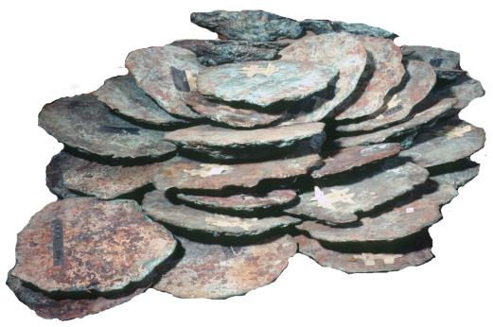
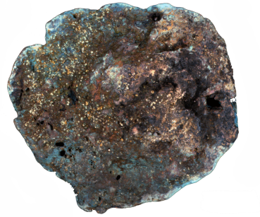
El Nuevo Constante
Photograph by Coastal Environments, Inc.
Copper ingots from El Nuevo Constante
Notes:
El Nuevo Constante – A.D. 1766
Archaeologists recovered many copper ingots from the Constante. On the left is a photograph of a pile of copper ingots. Next to it is a close up of a single ingot. The copper ingots measured 12 to 24 inches in diameter, and weighed 23 to 145 pounds. Most weighed 60 to 90 pounds.
Image credit: Coastal Environments, Inc.

Slide 21
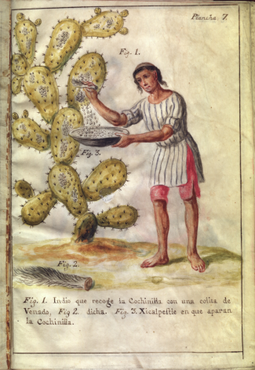
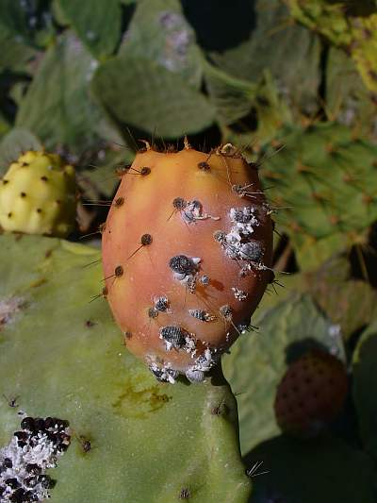
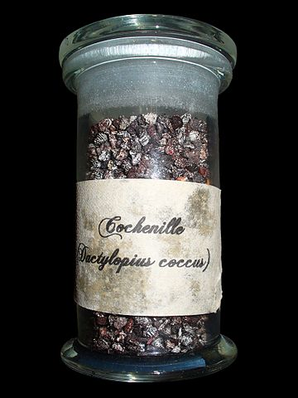
El Nuevo Constante
Indian collecting cochineal insects
Live and dried cochineal insects
Newberry Digital Collections for the Classroom
Photographs by H. Zell; Wikimedia Commons
Cochineal for making red dye
Notes:
El Nuevo Constante – A.D. 1766
The Constante transported items used to make dyes, such as cochineal. Cochineal comes from the dried bodies of the female cochineal insect and was used to make red dye. These insects live on the prickly pear cactus, and eat the red buds. They were valued for their deep and rich color. Cochineal dye is also in modern products, such as catsup, red Jell-O® and flavored yogurt. Look at labels on red-colored items for “cochineal extract” or “E-120.” These are common ways to list cochineal.
The drawing on the left is an Indian collecting cochineal insects. It is from a journal written in 1777. The photographs on the right show a modern cactus with cochineal insects, and dried insects used in the dye making process. Cochineal was the second most valuable export item for Mexico during colonial times, just behind silver. Indians grew cactus and raised the insects. They sold the dried product to Spanish merchants in Mexican markets. Some Indians gained power and wealth through the trade of cochineal with the Spanish.
Image credits:
Indian collecting cochineal insects – Newberry Digital Collection for the Classroom, http://dcc.newberry.org/items/indian-collecting-cochineal-with-a-deer-tail
Modern cactus and cochineal specimens –
By H. Zell - Own work, CC BY-SA 3.0, https://commons.wikimedia.org/w/index.php?curid=17313026; https://commons.wikimedia.org/wiki/File%3ADactylopius_coccus_05.JPG
By H. Zell - Own work, CC BY-SA 3.0, https://commons.wikimedia.org/w/index.php?curid=9726650
https://commons.wikimedia.org/wiki/File%3ADactylopius_coccus_03.jpg

Slide 22
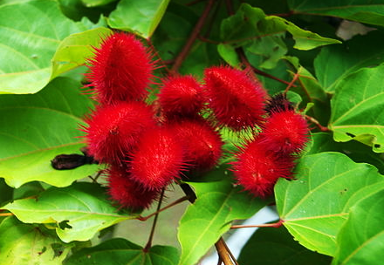
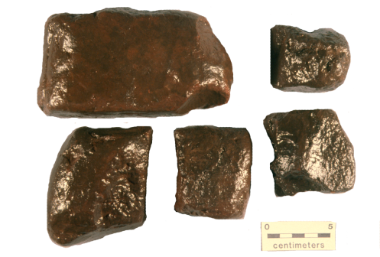
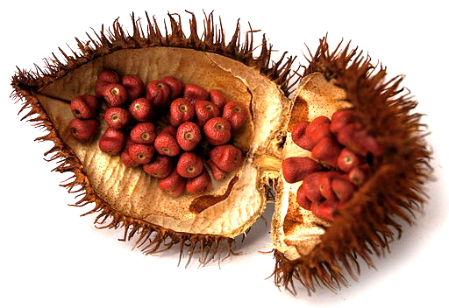
El Nuevo Constante
Photograph by Balou46; Wikimedia Commons
Photograph by Coastal Environments, Inc.
Achiote tree and seed pod
Photograph by Grupo Colombio
Dried blocks of annatto from the Constante
Annatto for making dyes
Notes:
El Nuevo Constante – A.D. 1766
Annatto was another dye shipped on the Constante. Annatto is a plant dye from the achiote tree, which is native to Mexico and Central America. Indians used it to dye cloth and yarn, to color foods, and as color on their faces. The photographs on the left show an achiote tree and an open seed pod. On the right are the dried blocks of annatto from the Constante. Archaeologists recovered 19 pounds from the site.
Today, annatto adds the red-orange color to products such as cheese, dairy spreads, snack foods, and breakfast cereals. It is in Latin American and Caribbean cooking to add color and seasoning.
Image credits:
Achitoe tree – By Balou46 (Own work) [CC BY-SA 4.0 (http://creativecommons.org/licenses/by-sa/4.0)], via Wikimedia Commons; https://commons.wikimedia.org/wiki/File%3ACR-tree-of-life-annatto.jpg
Seed pod – By Grupo Colombio (Own work) [CC BY-SA 3.0 (http://creativecommons.org/licenses/by-sa/3.0)], via Wikimedia Commons; https://commons.wikimedia.org/wiki/File%3AAchiote_Urucu.jpg
Annatto specimens - Coastal Environments, Inc.

Slide 23
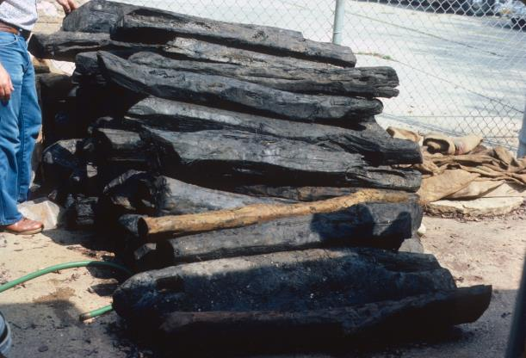
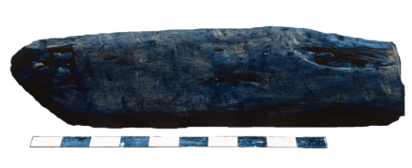
El Nuevo Constante
Photographs by Coastal Environments, Inc.
Logwood from El Nuevo Constante
Notes:
El Nuevo Constante – A.D. 1766
Archaeologists recovered lots of wood from the Constante. Here are photographs of logwood, also known as dyewood. Logwood can make a dark blue or red dye, depending on what is added. Archaeologists cut open a log, chipped off smaller pieces, and fermented them in water. The wood was still able to produce a dark blue dye after 200 years underwater! The photograph on the left is a pile of logwood, and on the right is a single piece with a scale. This scale is in 5 centimeter sections. It shows that the piece is about 70 centimeters, or 27 inches long.
The salt water and clay soil of the site worked well to preserve organic remains, like this wood. Once the wood was removed from the site it had to be protected from decay. To find out more about this process, do an internet search on “preserving wood from salt water environments.” Some archaeologists are experts in this field.
Image credit:
Coastal Environments, Inc.

Slide 24
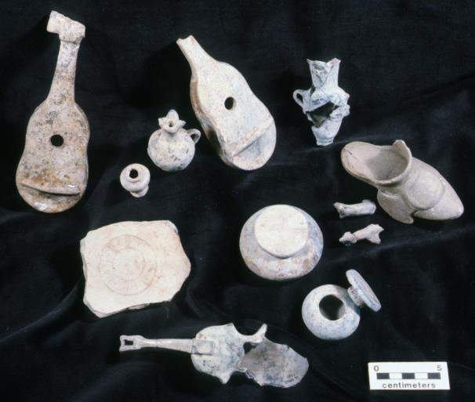
El Nuevo Constante
Photograph by Coastal Environments, Inc.
Small ceramic items from El Nuevo Constante
Notes:
El Nuevo Constante – A.D. 1766
These are small ceramic items recovered from the Constante. They were made in Mexico for people in Europe. Some of these might have been the “gifts” on the cargo list.
Image credit: Coastal Environments, Inc.

Slide 25
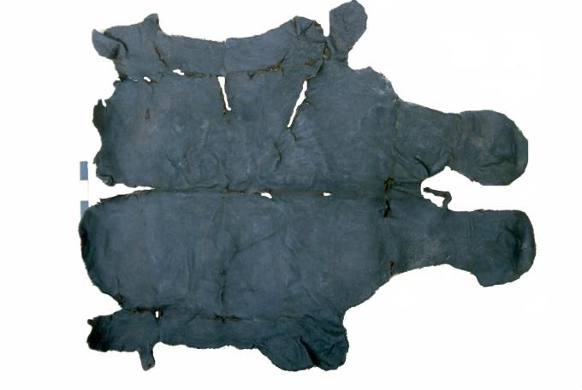
El Nuevo Constante
Photograph by Coastal Environments, Inc.
Tanned cow hide from El Nuevo Constante
Notes:
El Nuevo Constante – A.D. 1766
This is a tanned cow hide recovered from the Constante. Cow hides were a popular item in colonial times. The Constante carried over 2,000 tanned hides, and 25 goat skins. These items were bound for the Spanish market.
Image credit: Coastal Environments, Inc.

Slide 26
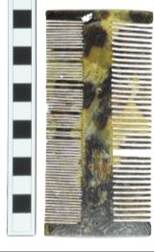
El Nuevo Constante
Tortoise shell from El Nuevo Constante
cm
Spanish two-sided tortoise shell comb
(Odyssey Marine Exploration)
Tortoise Shell
Notes:
El Nuevo Constante – A.D. 1766
The photograph on the left is tortoise shell recovered from the Constante. Traders would take raw materials, such as this tortoise shell, back to Spain to be made into other products for sale in Europe. Popular tortoise shell items were combs and cases. The photograph on the right is an example of a tortoise shell comb from the colonial period.
Image credits: Tortoise shell from El Nuevo Constante – Louisiana Division of Archaeology
Spanish colonial tortoise shell comb – Odyssey Marine Exploration www.odysseymarine.com
Odyssey’s Virtual Museum www.odysseysvirtualmuseum.com

Slide 27
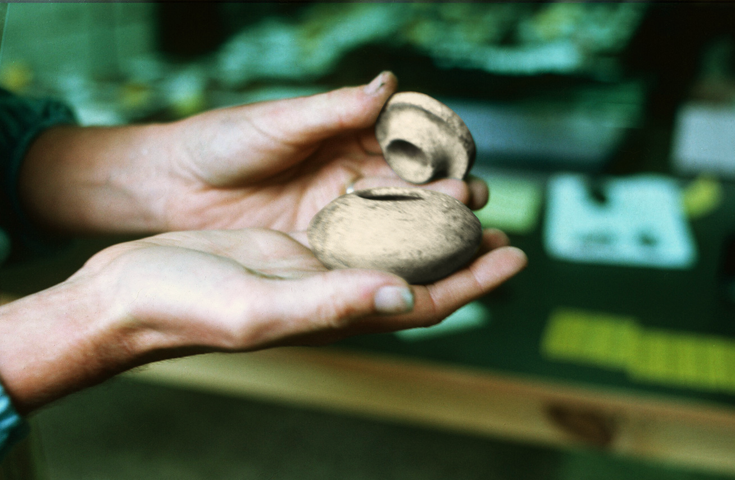
El Nuevo Constante
Courtesy of Latin American Studies
Human story through archaeology
Notes:
El Nuevo Constante – A.D. 1766
Archaeology added to the story of the Constante. This ship was involved in the everyday business of trade and commerce. Artifacts from the wreck provided a glimpse into the lives of ordinary people making a living during the colonial period. Spain and its Mexican colonists conducted business, and trade and commerce took place on both sides. Proof of this was in the discovery of the ceramic items and raw materials aboard the Constante. Many of these items were made by Mexican people and bound for markets in Spain.
Archaeology also provided the first accurate image of the Constante. An artist drew pictures of the ship from the data collected from the site, both historical and archaeological. There were no known drawings of the Constante before this archaeology project.
Archaeology gave us the story of the people of the Constante, and a glimpse into commerce and trade in the Spanish colonial world.
Image credit: Louisiana Office of Tourism

Slide 28
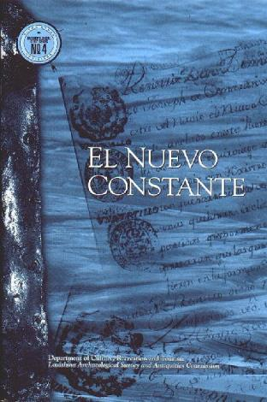
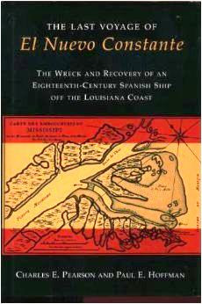
El Nuevo Constante
Virtual Book
Published Book
El Nuevo Constante Publications
Notes:
El Nuevo Constante – A.D. 1766
The Constante remains underwater. Artifacts and records from this project are stored with the Louisiana Division of Archaeology. The Division has a traveling exhibit available to teachers and other professionals which includes both replicas and actual artifacts. Visit the website for information on this exhibit, as well as a virtual book and an interactive exhibit at www.crt.la.gov/DiscoverArchaeology.
Researchers on the project wrote a book called The Last Voyage of El Nuevo Constante. This book contains detailed information about the site discovery, historical research, archaeological excavation, and artifact analysis. You can purchase this book online at Amazon and Barnes and Noble. It may also be available at your local library.
Image credits:
El Nuevo Constante virtual book – Louisiana Division of Archaeology www.crt.la.gov/DiscoverArchaeology
The Last Voyage of El Nuevo Constante – Louisiana State University Press

Slide 29
El Nuevo Constante 1766
This presentation is one in a series of modules about Louisiana archaeology. Each module has a PowerPoint presentation and associated student activities. The series is called “Learn about Louisiana’s Past through Archaeology.”
This presentation is intended for educational use. Please use image credits where provided.
Please visit the Division of Archaeology website for additional teaching materials and educational resources at: www.crt.la.gov/DiscoverArchaeology/.
Presented by:
Louisiana Division of Archaeology
Office of Cultural Development
Department of Culture, Recreation and Tourism
Office of the Lieutenant Governor
Baton Rouge, Louisiana
This project was made possible through the Governor's Office of Homeland Security and Emergency Preparedness (GOHSEP) and the Federal Emergency Management Agency (FEMA) as part of implementing the Louisiana Hazard Mitigation Grant Program for Hurricane Katrina recovery.
© Louisiana Division of Archaeology 2016

