Slide 1
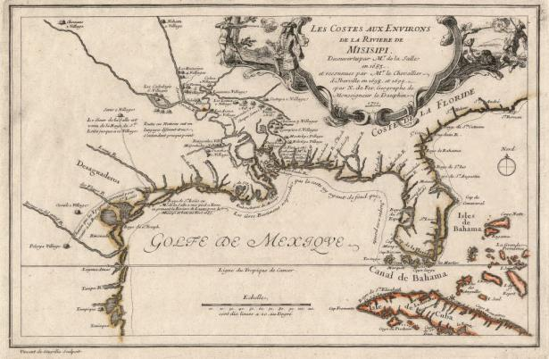
Los Adaes 1721 to 1773
Learn about Louisiana’s Past through Archaeology
Notes:
Los Adaes – A.D. 1721 to A.D. 1773
Image Credit: Library of Congress Control Number 2003623128

Slide 2
Los Adaes
Library of Congress Control Number 2003623128
French map of the Mississippi River and Gulf of Mexico, 1701
Notes:
Los Adaes – A.D. 1721 to A.D. 1773
This module introduces the colonial site of Los Adaes, a Spanish fort in west Louisiana. This is a French map drawn in 1701. France and Spain each ruled Louisiana during its colonial history. This map doesn’t have the outlines of the states as we know them today, but you can probably recognize the area we know as Louisiana. Can you outline or identify Louisiana on this map? What other states can you outline or identify?
Image Credit: Library of Congress Control Number 2003623128

Slide 3
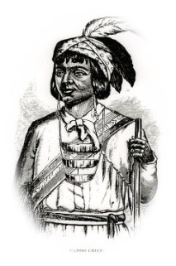
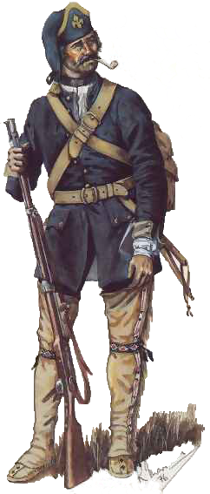
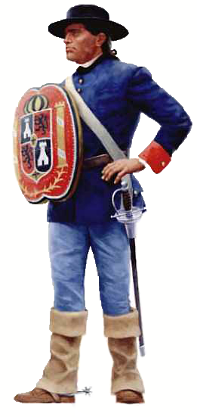
Los Adaes
Los Adaes (A.D. 1721-1773)
Spanish fort in west Louisiana
Served as capital of the province of Texas from A.D. 1729 to 1768
Daily life on the frontier
Rare cultural exchange between Spanish, French, and Caddo
Descendants of the people from Los Adaes live in area today
Caddo Chief
(Homer Thrall)
French Colonial soldier
(Canadian War Museum)
Spanish Colonial soldier
(NPS-San Antonio Missions)
Notes:
Los Adaes – A.D. 1721 to A.D. 1773
Los Adaes was a Spanish fort in west Louisiana, near Natchitoches. Los Adaes was part of New Spain, and served as the capital of the Spanish province of Texas from 1729 to 1768. Several independent powers were in this area at the time of Los Adaes. The French were at Natchitoches, and the Spanish were at Los Adaes. There was also a group of Indians, the Caddo, who lived in this area. Archaeologists know that the Caddo lived in the area for a long time before Europeans came.
Los Adaes gives us a look into the daily life at a Spanish colonial fort. Archaeologists also discovered evidence of rare cultural exchange between the Spanish and French colonists, and Caddo Indians at Los Adaes. Descendants of the people of Los Adaes, called Adaeseños, still live in this area today.
Image credits:
Caddo Chief – Thrall, Homer S. A pictorial history of Texas, from the earliest visits of European adventurers, to A.D. 1879. . . . Book, 1879; (http://texashistory.unt.edu/ark:/67531/metapth5828/ : accessed May 08, 2015), University of North Texas Libraries, The Portal to Texas History, http://texashistory.unt.edu.
French colonial soldier – CWM 19810948-026, Beaverbrook Collection of War Art, Canadian War Museum
Spanish colonial soldier - NPS-San Antonio Missions National Historical Park http://www.nps.gov/pais/historyculture/spanish.htm

Slide 4
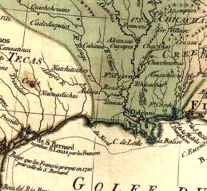
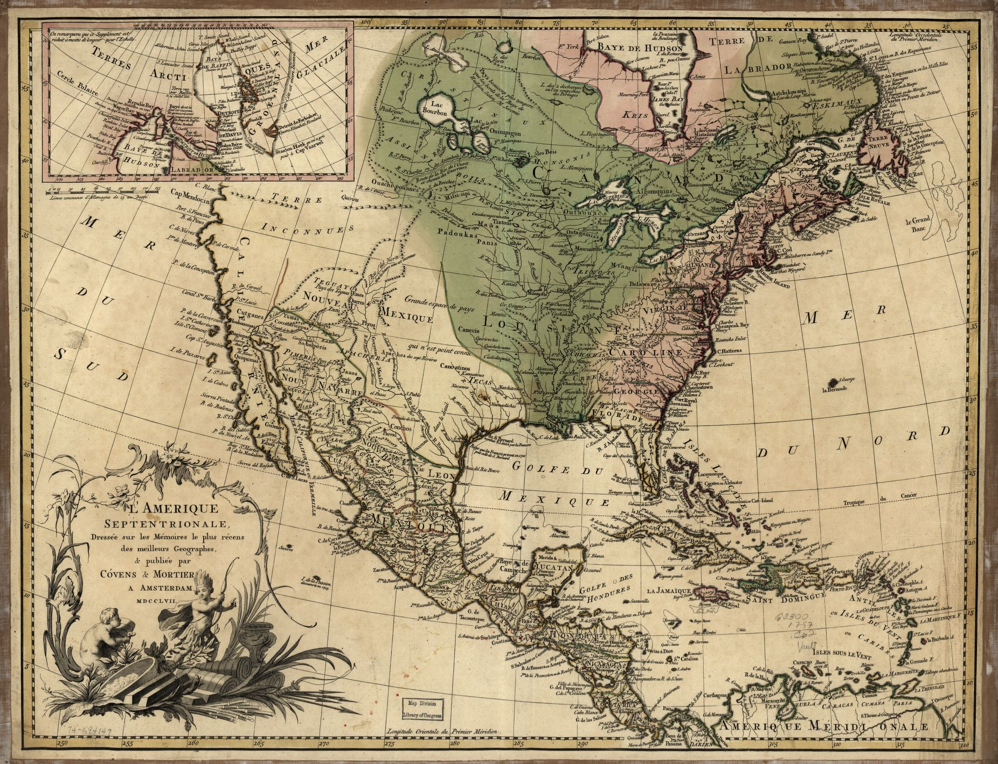
Los Adaes
Natchitoches
Los Adaes
New Spain 1757, Courtesy of Library of Congress g3300 ar007601
Mexico City
Map of North America, 1757
Notes:
Los Adaes – A.D. 1721 to A.D. 1773
This is a map of North America from 1757. It shows the British land in pink. The French land is green, and the Spanish land, known as New Spain, is tan. “New Spain” was huge, and referred to the Spanish colonies in the New World. Among many places you may recognize on this map, New Spain included Mexico, Texas, and a small part of western Louisiana. Can you list current U.S. states that were part of New Spain?
The government of New Spain was located in Mexico City. Los Adaes was the most eastern outpost of the Spanish empire. Los Adaes was the dead end of a royal road, or “El Camino Real.” Royal roads connected Mexico City to its settlements. The long distance from Mexico City made it difficult to supply Los Adaes with weapons and everyday items. Spain built the settlement at Los Adaes to protect its territory from France. Los Adaes defended the eastern edge of the Spanish colony. The French fort at Natchitoches defended the western edge of the French colony.
Image credit: New Spain 1757, Courtesy of Library of Congress g3300 ar007601

Slide 5
Los Adaes
St. Denis founds Natchitoches A.D. 1714
Los Adaes is built A.D. 1721
LaSalle claims
Louisiana for France
A.D. 1682
Louisiana Purchase
A.D. 1803
de Soto expedition
in Louisiana
A.D. 1542
Pre-European Contact Period
A.D. 1400-1500
Colonial Period
A.D. 1500 -1803
A.D. 1400 | A.D. 1500 | A.D. 1600 | A.D. 1700 | A.D. 1800
Renaissance Period
begins in Italy
A.D. 1400
Scientific Revolution
begins in Europe
A.D. 1600
American Revolution
begins A.D. 1775
Ponce de Leon
discovers Florida
A.D. 1513
Columbus in the
New World
A.D. 1492
Age of Enlightenment
begins in Europe
A.D. 1700
Treaty of Paris
Revolutionary War
ends A.D. 1784
Timeline of events from A.D. 1400 to A.D. 1803
Notes:
Los Adaes – A.D. 1721 to A.D. 1773
Let’s put Los Adaes in the context of early colonial activity in Louisiana, and what was going on in the rest of the United States and the world. Here is a timeline of events from A.D. 1400 to 1803.
Image credit: Louisiana Division of Archaeology

Slide 6
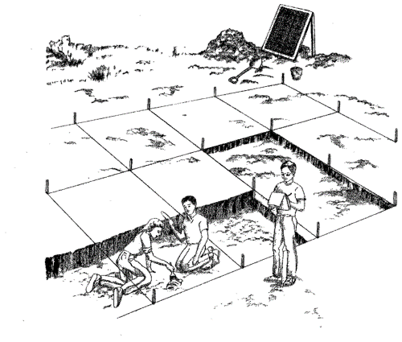
Los Adaes
?
Historical Records
Artifacts
What do they tell us
Notes:
Los Adaes – A.D. 1721 to A.D. 1773
Some of what we know about Los Adaes is from historical records, like maps. And, some of what we know is through archaeology. This module provides a detailed look at artifacts and other information from the site. Some artifacts show a rare cultural exchange took place at Los Adaes. At the end of the module, we’ll talk about what all these kinds of information tell us about Los Adaes.
Are you ready? Let’s begin.
Image credit: Intrigue of the Past (1992) United States Department of the Interior, Bureau of Land Management

Slide 7
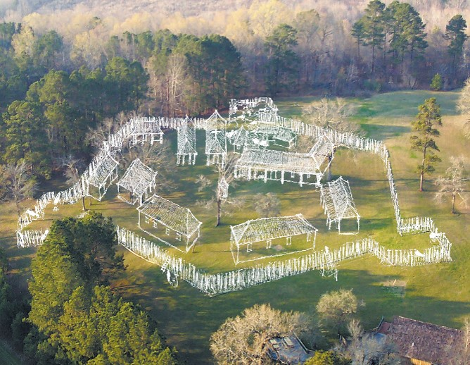
Los Adaes
Aerial photograph by Tommy Hailey; illustration by Sergio Palleroni
Los Adaes site drawn on aerial photograph
Notes:
Los Adaes – A.D. 1721 to A.D. 1773
Here is a drawing of the fort at Los Adaes. The artist drew it over an aerial photograph of the site. Archaeology and historical documents, such as maps, provided the information for this drawing.
Image credits:
Aerial photograph – Tommy Hailey, Northwestern State University, Natchitoches
Illustration – Sergio Palleroni

Slide 8
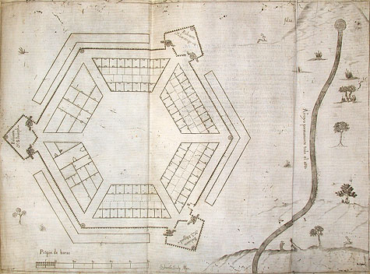
Los Adaes
Photograph by Paco Link; Benson Latin American Collection, University of Texas at Austin
Architectural plan of fort at Los Adaes
Notes:
Los Adaes – A.D. 1721 to A.D. 1773
This is an architectural plan of the Los Adaes fort. At first, scholars didn’t think that this was the final design of the fort because it was so elaborate. Archaeologists were able to locate many of the features of the site that are on this drawing. Their work confirmed the fort was built according to this plan.
Image credits: Photograph by Paco Link; Benson Latin American Collection, University of Texas at Austin Q-GZZ 976.4 P37D LAC-ZZ

Slide 9
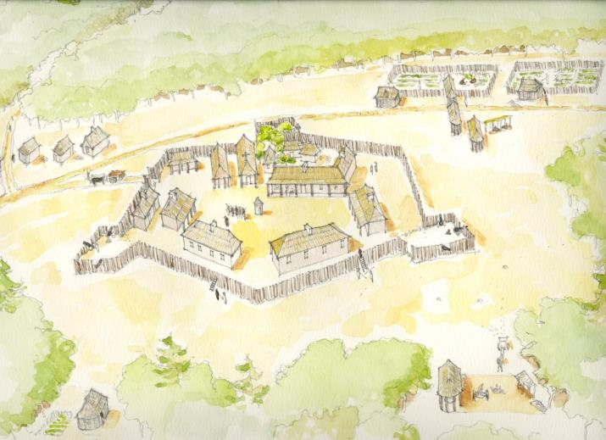
Los Adaes
Crops
Chapel
Guard House
Governor’s House
Officers’ Barracks
Soldiers’ Barracks
Soldiers’ Barracks
Gun Powder
House
Illustration by Sergio Palleroni
What Los Adaes looked like while in use
Notes:
Los Adaes – A.D. 1721 to A.D. 1773
This is a drawing of what the Los Adaes site looked like when it was in use. The artist used information from historical records, such as maps, and archaeology to draw the various areas of the fort.
Image credit: Sergio Palleroni

Slide 10
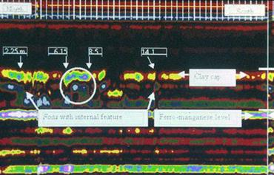
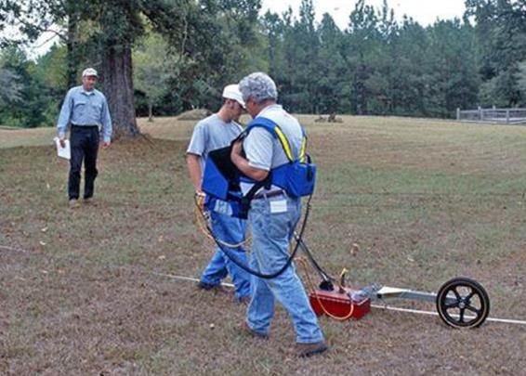
Los Adaes
GPR data by Marco J. Giardino, NASA (retired)
Photograph by Jeff Girard
Ground penetrating radar (GPR) at Los Adaes
Notes:
Los Adaes – A.D. 1721 to A.D. 1773
Archaeologists use a variety of technologies in their work. Here is a photograph of ground penetrating radar (GPR) used at Los Adaes. A sample read-out of data is to the right. GPR helps archaeologists “see” what is in the ground before digging. It works by sending an energy pulse into the ground, and this pulse bounces back off anything in its path. A computer records the amount of time it takes for this signal to return. Items in the ground reflect signals at different speeds. Even disturbed soil will reflect the signal differently from soil that has not been disturbed. A computer makes a “picture” of what is underground based on these signals. Unusual readings indicate a disturbance in the soil, and these disturbances often lead archaeologists to buried objects.
Image credits:
People using GPR – Jeff Girard, Northwestern State University
GPR data – Marco J. Giardino, NASA (retired)

Slide 11
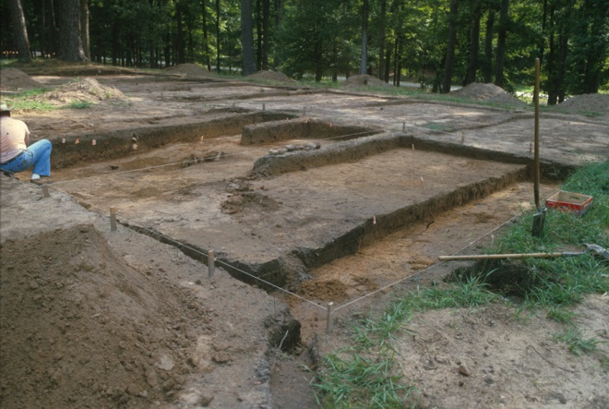
Los Adaes
Photograph from Pete Gregory, Northwestern State University
Excavation of a kitchen area at Los Adaes
Notes:
Los Adaes – A.D. 1721 to A.D. 1773
Excavations at Los Adaes have been going on for several years. Here is a photograph of the excavation of one of the kitchen areas at the site. Notice the wooden stakes and string. This is how archaeologists mark the area for excavation.
Archaeologists have excavated only 5% of the site. Excavation is a destructive technique, so they rarely dig a site completely. Archaeologists know technology will continue to improve, and that future technology could reveal more about a site without the need to dig.
Image credit: Pete Gregory, Northwestern State University

Slide 12
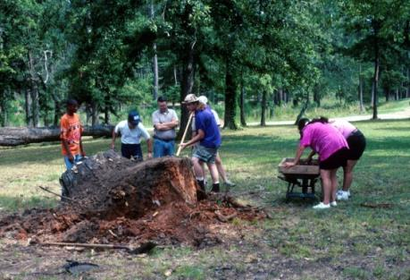
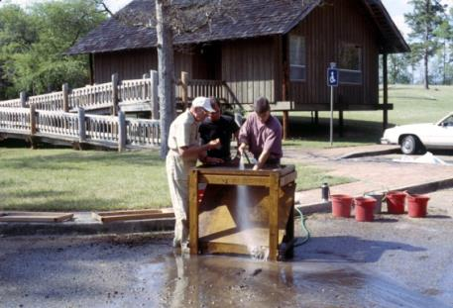
Los Adaes
Dry screening at tree stump (1996)
Photographs by George Avery
Water Screening (1996)
Screening for artifacts at Los Adaes
Notes:
Los Adaes – A.D. 1721 to A.D. 1773
Archaeologists generate a lot of dirt. Sometimes that dirt contains artifacts. Archaeologists “screen” this dirt to find small artifacts that could have been missed when digging. For example, small bones or glass beads can easily be over-looked. These small artifacts help tell a more complete story of the activities at a site.
Here are two photographs of screening at Los Adaes, dry screening and water screening. Dry, loose soil can be dry screened, while more compact and moist soil may require water screening.
Image credit: George Avery

Slide 13
Los Adaes
Artifacts at Los Adaes (A.D. 1721-1773)
American Indians in area long before Europeans
Military and daily activities at Los Adaes
Cultural exchange between Spanish, French, and Caddo
Notes:
Los Adaes – A.D. 1721 to A.D. 1773
The next slides feature a variety of artifacts found at Los Adaes. Some artifacts represent the presence of American Indians in the area of Los Adaes long before Europeans. Many artifacts represent military activities at the site, such as guns. Other artifacts represent daily life at Los Adaes, such as religious charms and medals, dishes, eating utensils, and nails. Some artifacts speak of a rare cultural exchange between the Spanish, French and Caddo at the site. No other colonial forts in Texas and Louisiana show this cultural exchange.

Slide 14
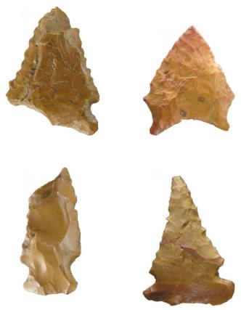
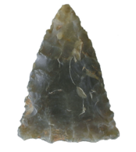
Los Adaes
Paleoindian Period
Colonial Period
Photographs by George Avery
Stone points from Los Adaes
Notes:
Los Adaes – A.D. 1721 to A.D. 1773
The stone points on the left are from a time long before Europeans settled at Los Adaes. Archaeologists know these points are from the Paleoindian Period, about 7000 B.C. These are a reminder that Indians lived in the area for at least 8000 years before Europeans arrived. The stone point on the right is also from Los Adaes. This was a style used at the time of European settlement in the area.
Archaeologists did not find evidence that people made stone points at Los Adaes. It’s possible that once Europeans came to the area, guns took the place of bows and arrows.
Image credit: George Avery

Slide 15
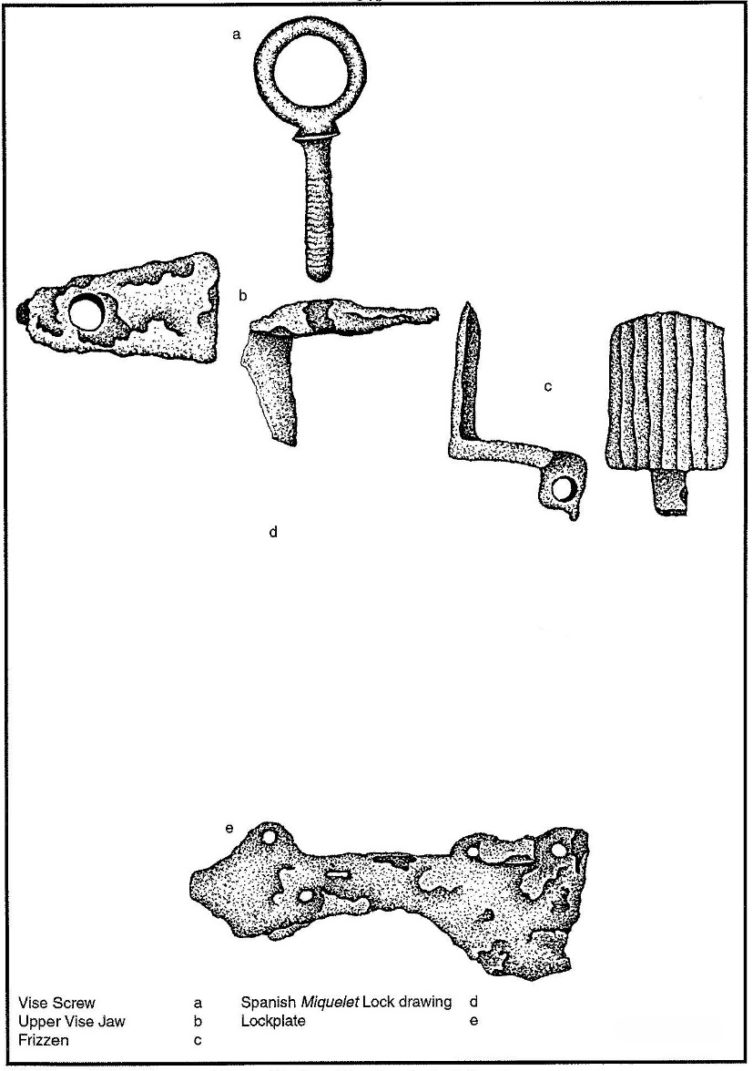
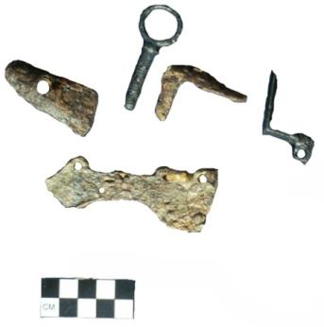
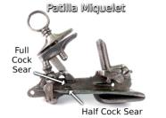
Los Adaes
Lockplate
Upper Vise Jaw
Vise Screw
Drawings by Melinda Parrie; Photograph by Dana Williams
Frizzen
Photograph by Goerge Avery
Spanish gun parts from Los Adaes
Notes:
Los Adaes – A.D. 1721 to A.D. 1773
Archaeologists discovered European guns at Los Adaes. Guns were not just for military activities at frontier sites. They were often used for hunting. Here are Spanish gun parts found at the site. In the middle of the drawing is a figure showing how these parts fit together. Note the scale in the photograph of the artifacts. Each square equals one centimeter. Archaeologists use a variety of scales to give a better idea of the size of objects.
These pieces of a gun made in Spain were not unexpected at a Spanish fort. We will see other artifacts that represent interaction between the Spanish, French and Caddo Indians at Los Adaes.
Image credits:
Drawing – Melinda Parrie
Patillo Milquelet – By Dana Williams (Own work) [CC BY-SA 3.0 (http://creativecommons.org/licenses/by-sa/3.0)], via Wikimedia Commons http://commons.wikimedia.org/wiki/File%3APatilla_Style_Miquelet_Lock.jpg
Photograph – George Avery

Slide 16
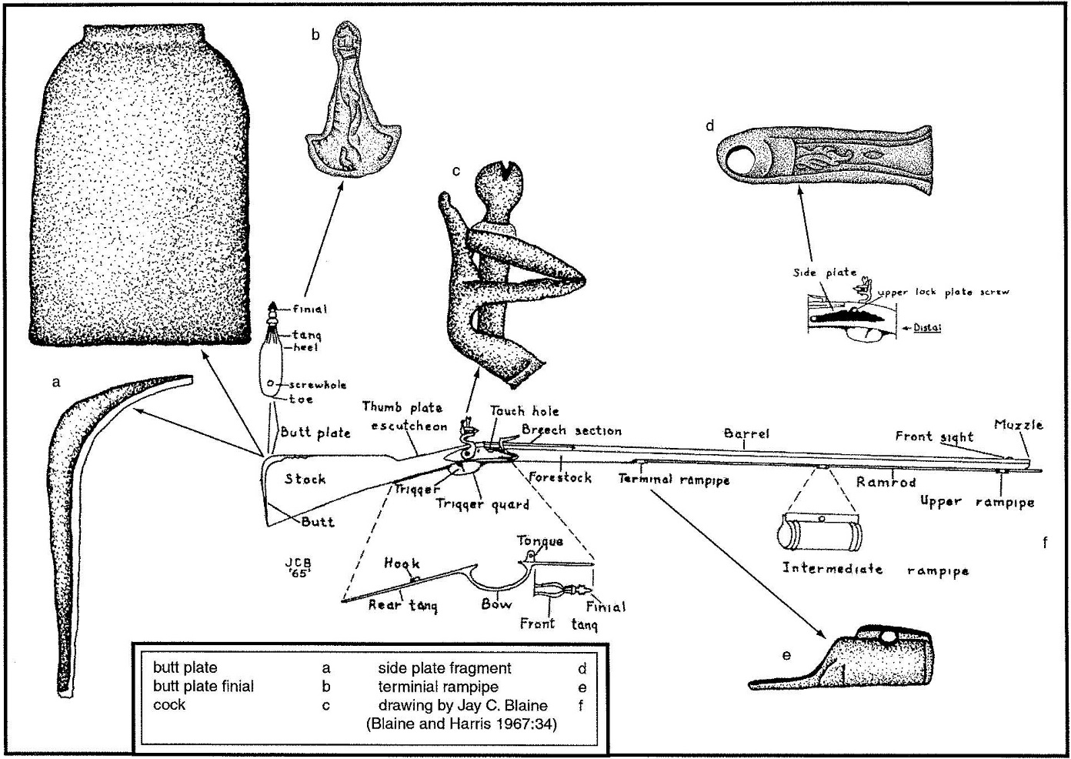
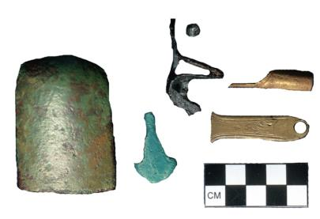
Los Adaes
Drawings by Jay Blaine and Melinda Parrie
Photograph by George Avery
French gun parts from Los Adaes
Notes:
Los Adaes – A.D. 1721 to A.D. 1773
These are French gun parts from Los Adaes. On the left is a drawing of the artifacts, and includes a drawing in the center of a complete French gun showing how the parts fit together. Can you match the artifacts with the drawings?
The discovery of these French gun parts at Los Adaes confirmed interaction between the French and Spanish. At this time, Spain and France were enemies in Europe. Spain said its colonists could trade with French colonists for food items, but not merchandise, like this gun. Archaeologists discovered these French gun parts, as well as other French items at Los Adaes that showed trade with the French went beyond what Spain allowed on paper.
Image credits:
Drawings – Jay Blaine (French gun) and Melinda Parrie (gun parts)
Photograph – George Avery

Slide 17
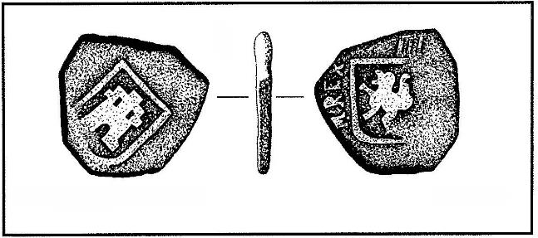
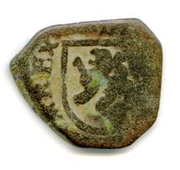
Los Adaes
Photograph by
Don Sepulvado
Drawing by Melinda Parrie
Spanish coin from Los Adaes
Notes:
Los Adaes – A.D. 1721 to A.D. 1773
This is a drawing and photograph of a Spanish coin from Los Adaes. It is made of copper alloy. Archaeologists are not sure who had this Spanish coin. It could have belonged to a Spanish or Caddo person at Los Adaes.
Image credits:
Coin Drawing – Melinda Parrie
Coin Photograph – Don Sepulvado; Williamson Museum, Northwestern State University, Natchitoches, Louisiana

Slide 18
Los Adaes
Hole
Photograph by George Avery
French coin from Los Adaes
Notes:
Los Adaes – A.D. 1721 to A.D. 1773
Here is a photograph of a French coin found at Los Adaes. It is also made of copper alloy. Archaeologists are not sure who had this French coin. It could have belonged to a Spanish or Caddo person at Los Adaes. Or it could have belonged to a French person who lost it while visiting the fort.
There is a hole through this coin, which meant that it was likely part of a necklace. Some cultures believe that copper was a remedy for rheumatism and joint aches. Perhaps the person who owned this coin suffered from one of these ailments.
Image credit: Goerge Avery

Slide 19
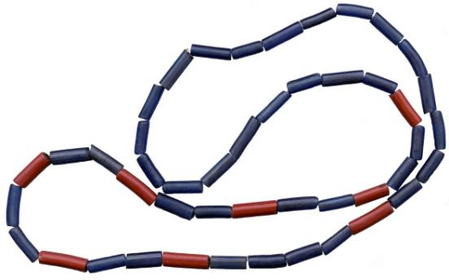
Los Adaes
Photograph by George Avery
European glass trade beads from Los Adaes
Notes:
Los Adaes – A.D. 1721 to A.D. 1773
These are European glass trade beads found at Los Adaes. They were brought to North America to trade with the Indians. The Caddo were mostly on good terms with the Spanish and French, and often traded with their European neighbors. In return for European items, the Caddo provided corn, beans, meat, and deerskins. Many of the Caddo trade goods did not preserve well at the archaeological site.
Image credit: George Avery

Slide 20
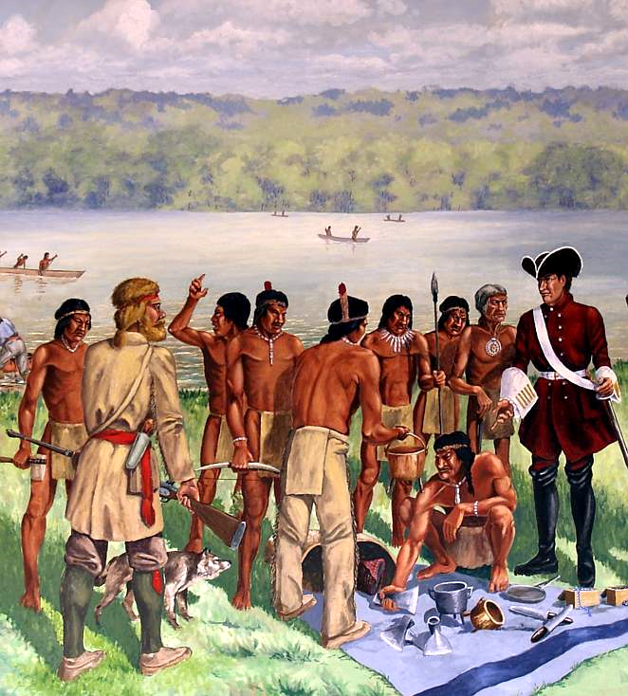
Los Adaes
1 Musket = 30 deerskins
5 ball shot with gunpowder = 1 deerskin
6 gunflints = 1 deerskin
1 belt knife = 2 deerskins
1 axe or 1 hoe = 8 deerskins
1 hatchet = 5 deerskins
1 large bell = 6 deerskins
6 small bells = 1 deerskin
1 metal bracelet = 1 deerskin
1 trade shirt = 8 deerskins
1 1/3 yards of cloth = 20 deerskins
H.B. Wright; Louisiana State Exhibit Museum, Shreveport
Trade between Indians and Europeans
Notes:
Los Adaes – A.D. 1721 to A.D. 1773
You’re probably wondering about the price the Caddo paid for European goods. On the right is a “price list” between the Spanish and the Caddo Indians at Los Adaes. As you can see, no money was used. This kind of trade is called barter. In addition to the glass beads, the Caddo traded for things like metal knives and tools, ammunition, various small metal items, and European cloth.
Do you think these prices were fair? You could compare hunting deer and curing the skin to making some of these European items, and discuss with the class whether these were fair trades.
Image credit: The Founding of Natchitoches by Louis Juchereau de St. Denis, 1714 by H.B. Wright; Louisiana State Exhibit Museum, Shreveport

Slide 21
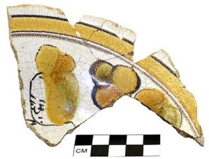
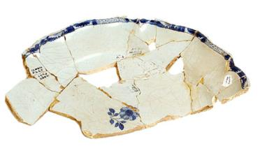
Los Adaes
Mexican ceramic
(photograph by George Avery)
French ceramic
(photograph by Don Sepulvado)
Mexican (left) and French (right) ceramics from Los Adaes
Notes:
Los Adaes – A.D. 1721 to A.D. 1773
These are examples of Mexican and French ceramic dishes found at Los Adaes. Mexico and Los Adaes were both part of New Spain. The one from France found at the site is another example of interaction between colonists from Spain and France.
Image credits:
Mexican ceramic – George Avery
French ceramic– Don Sepulvado, Williamson Museum, Northwestern State University, Natchitoches

Slide 22
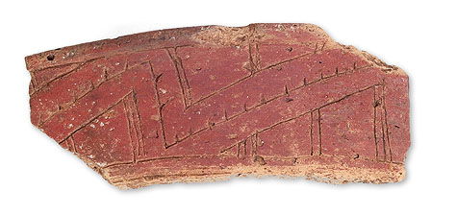
Los Adaes
0
1
2
3
4
5
cm
Photograph by George Avery
Caddo pottery piece from Los Adaes
Notes:
Los Adaes – A.D. 1721 to A.D. 1773
This is part of an Indian ceramic found at Los Adaes. Archaeologists discovered over 35,000 pieces of Indian pottery at this site. That was about 90% of all ceramics discovered at Los Adaes. Archaeologists think the Caddo Indians carried some of their trade items in this pottery, such as corn and beans.
This piece is 9.7 centimeters long. Do you know how long that is in inches?
Image credit: George Avery

Slide 23
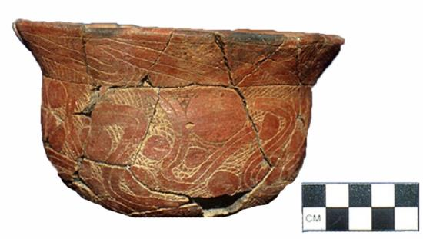
Los Adaes
Photograph by Don Sepulvado
Nearly complete Indian bowl from Los Adaes
Notes:
Los Adaes – A.D. 1721 to A.D. 1773
Here is another example of Caddo pottery from Los Adaes. This is a nearly complete Indian bowl. It was unique because it had designs. Most Caddo pottery at this time was plain, not decorated. Archaeologists think it might have been a gift to the governor of the Spanish territory. Archaeologists found it near the governor’s house.
Image credit: Don Sepulvado; Williamson Museum, Northwestern State University, Natchitoches

Slide 24
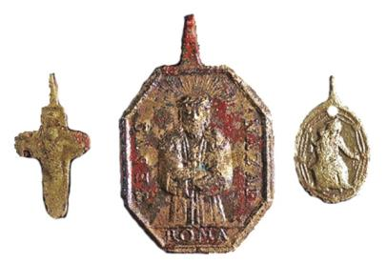
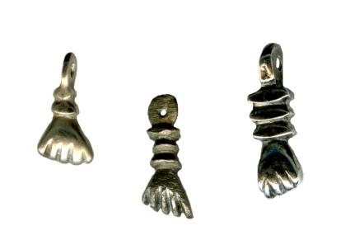
Los Adaes
Photographs by Don Sepulvado
Religious medals (left) and charms from Los Adaes
Notes:
Los Adaes – A.D. 1721 to A.D. 1773
These are religious medals and “higas,” or charms, found at Los Adaes. The items on the right are hand-shaped higas. Some cultures believed these charms could protect against danger or evil. This style was common throughout Spain and the Spanish New World.
Some of you may be more familiar with the Christian religious medals on the left. One of the medals has an image of Jesus on one side and St. John of Matha on the other. Another medal has an image of Mary and Jesus on one side, and Joseph on the other.
Archaeologists found many of these higas and other charms at Los Adaes. Artifacts like this, and the quantity found at this site, tell archaeologists that religion was part of daily life at Los Adaes.
Image credit: Don Sepulvado; Williamson Museum, Northwestern State University, Natchitoches

Slide 25
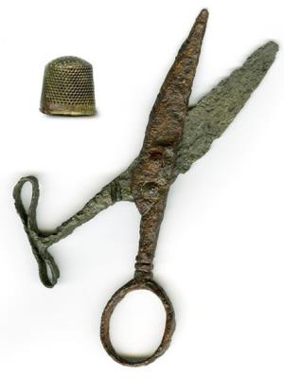
Los Adaes
Photographs by Don Sepulvado
Everyday artifacts from Los Adaes: fork, thimble and scissors
Notes:
Los Adaes – A.D. 1721 to A.D. 1773
The people at Los Adaes left behind everyday artifacts, like this fork, thimble and scissors.
Image credit: Don Sepulvado; Williamson Museum, Northwestern State University, Natchitoches, Louisiana

Slide 26
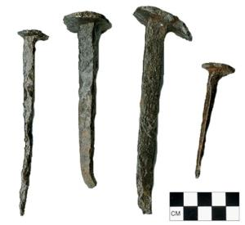
Los Adaes
Photographs by Don Sepulvado
Iron nails and wrought iron hook from Los Adaes
Notes:
Los Adaes – A.D. 1721 to A.D. 1773
These are photographs of iron nails and a fishing hook from Los Adaes. Nail making technology changed through time. The changes are well documented and published. Archaeologists consult these publications to compare their finds. This information helps tell the age of a site.
Image credit: Don Sepulvado, Williamson Museum, Northwestern State University, Natchitoches, Louisiana

Slide 27
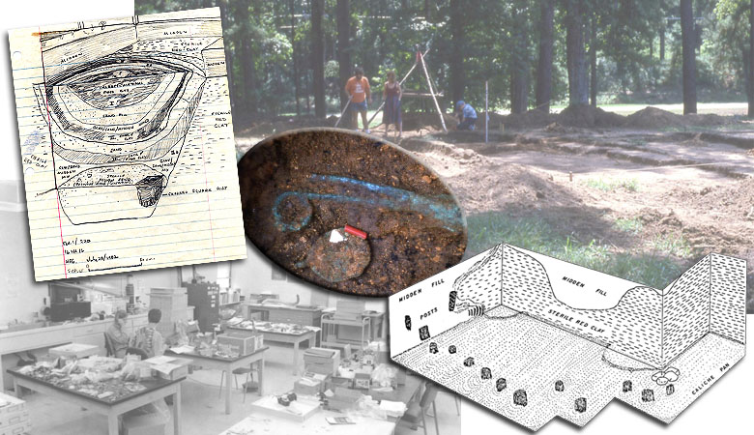
Los Adaes
Texas Beyond History, Texas Archeological Research Laboratory, University of Texas at Austin
Los Adaes and Archaeology
Notes:
Los Adaes – A.D. 1721 to A.D. 1773
Archaeology added to the story of Los Adaes. Ground penetrating radar revealed underground areas that were disturbed through construction of the fort. This data gave archaeologists an idea of where to begin their excavations. Excavations confirmed that the historic drawing was the design for the fort. Screening revealed small artifacts hidden in the excavated dirt. These artifacts were clues into the personal lives and religious beliefs of the people who lived there.
Archaeologists discovered artifacts that represented daily life at the site. Some artifacts represented a unique cultural exchange between Spanish and French colonists, and Caddo Indians. Archaeology told a more complete story of Los Adaes, especially about the people who lived there.
Image credit: Texas Beyond History, Texas Archeological Research Laboratory, University of Texas at Austin, www.TexasBeyondHistory.net

Slide 28
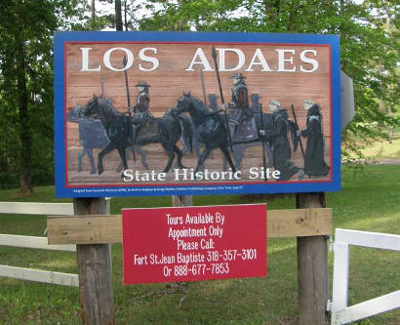
Los Adaes
Photograph by Louisiana State Parks
Los Adaes State Historic Site
Notes:
Los Adaes – A.D. 1721 to A.D. 1773
Today Los Adaes is a State Historic Site managed by the Louisiana Office of State Parks. You can visit the site, and take a tour of the spot of the original fort. Admission to the site is free but is accessible to the public by appointment only.
There is a website on Los Adaes available through the Louisiana Division of Archaeology http://www.crt.state.la.us/dataprojects/archaeology/LosAdaes/index_flash.html. Texas Beyond History also has a website with information on the Los Adaes site http://www.texasbeyondhistory.net/adaes.
Image credit: Louisiana Office of State Parks

Slide 29
Los Adaes 1721 to 1773
This presentation is one in a series of modules about Louisiana archaeology. Each module has a PowerPoint presentation and associated student activities. The series is called “Learn about Louisiana’s Past through Archaeology.”
This presentation is intended for educational use. Please use image credits where provided.
Please visit the Division of Archaeology website for additional teaching materials and educational resources at: http://www.crt.la.gov/archaeology/ (select Discover Archaeology).
Presented by:
Louisiana Division of Archaeology
Office of Cultural Development
Department of Culture, Recreation and Tourism
Office of the Lieutenant Governor
Baton Rouge, Louisiana
This project was made possible through the Governor's Office of Homeland Security and Emergency Preparedness (GOHSEP) and the Federal Emergency Management Agency (FEMA) as part of implementing the Louisiana Hazard Mitigation Grant Program for Hurricane Katrina recovery.
© Louisiana Division of Archaeology 2016
Notes:
Credits

