Slide 1
NAME OF RESOURCE
PARISH, LOUISIANA

Slide 2
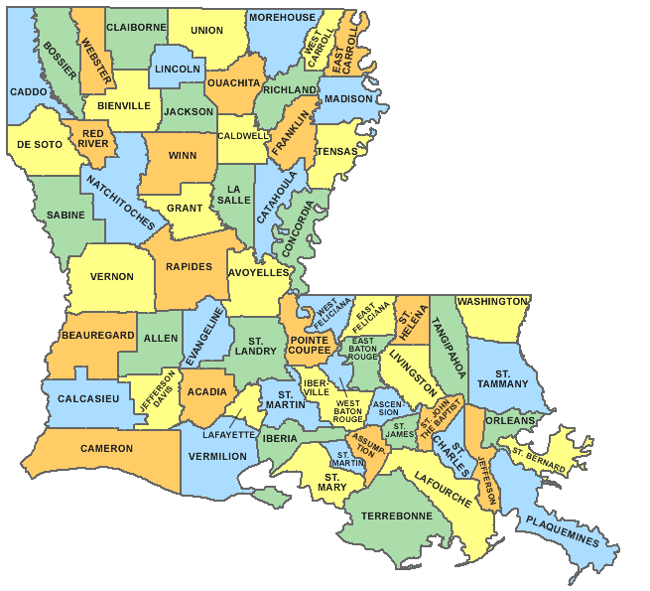
Resource Name, Name of Parish
Arrow pointing to parish location

Slide 3
Physical Description of the Resource
It’s best to just insert a photo of the resource and describe it as the audience looks at the photo.
Use this first slide for exterior photos

Slide 4
Interior Photos of the Resource, if applicable (i.e. districts only go by exterior photos)

Slide 5
Any alterations? Discussion of Integrity

Slide 6
Significance
Why is this resource significant? Bulleted points or just insert historic photos or maps of the resource and discuss its significance.

Slide 7
Significance, cntd

Slide 8
Use this for any additional photos or information

Slide 9
Use this for any additional photos or information

Slide 10
Conclusion
Summarize why this resource is being nominated
No more than 10 slides!!!

